Slide 1
Notes:
Cover Slide

Slide 2
Auto Assign Loading Plan for Kioxia Assembly in ATV
Presenter Name l Presenter Title
Notes:
Title Slide

Slide 3
Auto Assign Loading Plan for Kioxia Assembly in ATV
1
Background
2
Current ATV Operation
3
Compare with ATC Operation
4
Proposal for ATV
Notes:
Agenda/Outline Slide – Option 2

Slide 4
Background

Slide 5
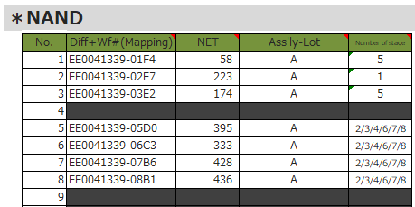
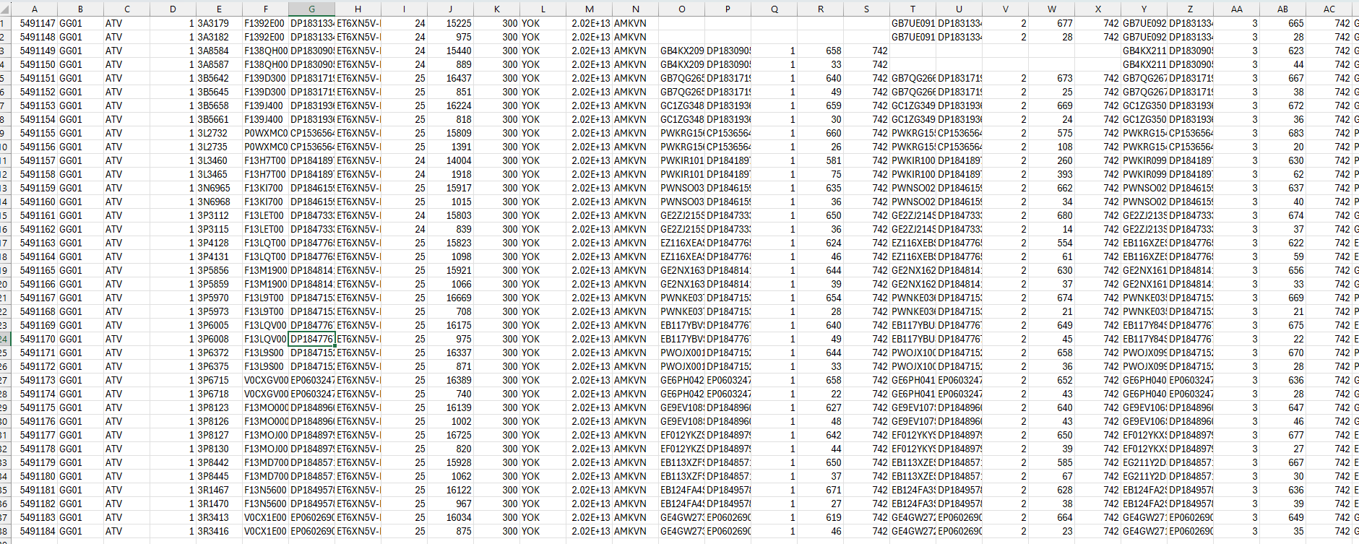
Background
In NPI stage, customer assigned specific wafer to specific Assembly lot. PCS based on this information to create loading plan
In MP, customer sends IASN Report to ATV/ATC.
This report is in csv format.
PCS based on this report to create loading plan
PCS then scheduled on eMES system
Figure A
Figure B

Slide 6
Current ATV Operation

Slide 7
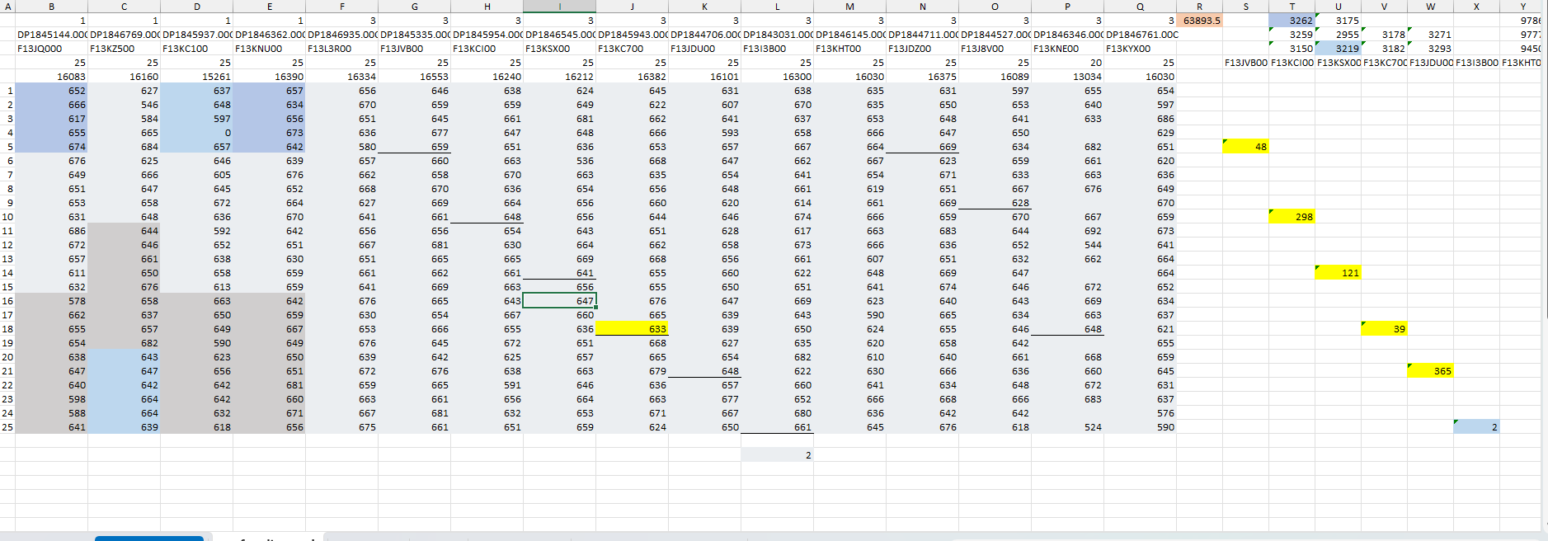
Current ATV Operation
PCS followed device’s specifications and assigned loading plan by themselves.
This task is manual, takes time and may have risk of wrong information input into system.
Loading plan is important for Assembly Production. Manual creating loading plan is hard to avoid typo.
Figure A

Slide 8
Compare with ATC Operation

Slide 9
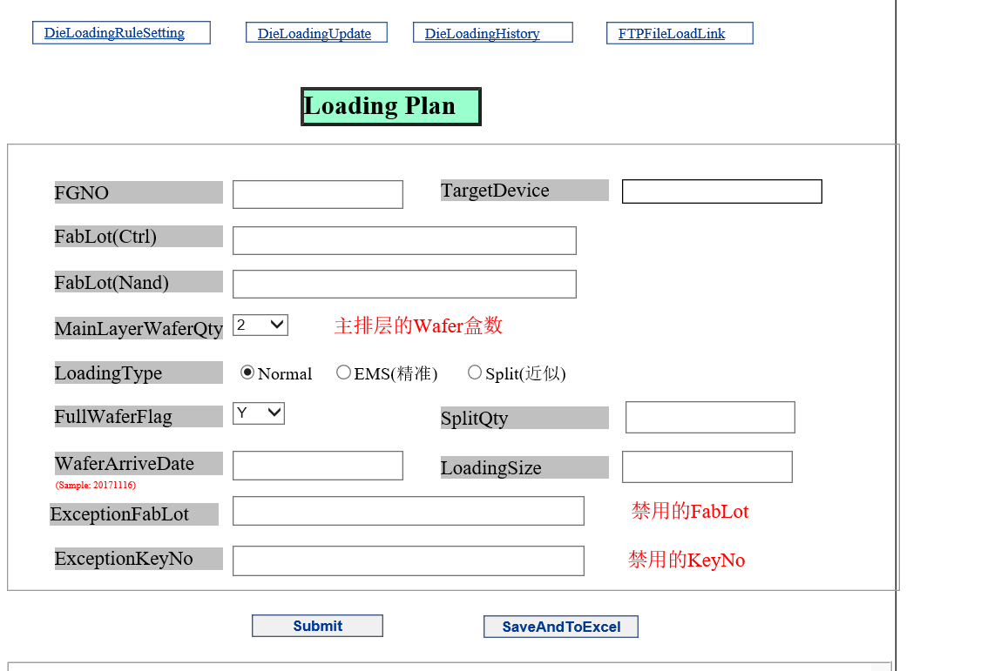
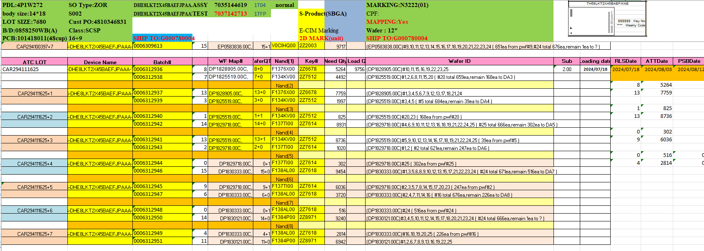
Compare with ATC Operation
ATC system is AMS.
ATC PCS set up by each FG with “Die Loading Rule Setting”.
System auto assign loading plan based on CSV files, got through FTP server.
System based on Rule Setting, first in first out rule to auto assign loading plan for Assembly.
ATC PCS review Loading plan (in Excel file format) and scheduled on system.
Figure A
Figure B

Slide 10
Proposal for ATV

Slide 11
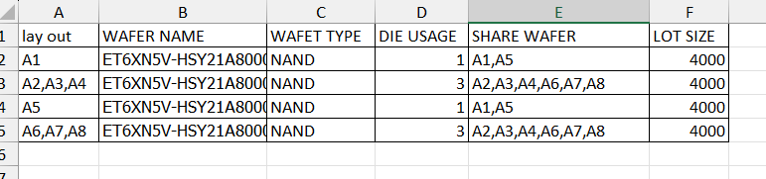
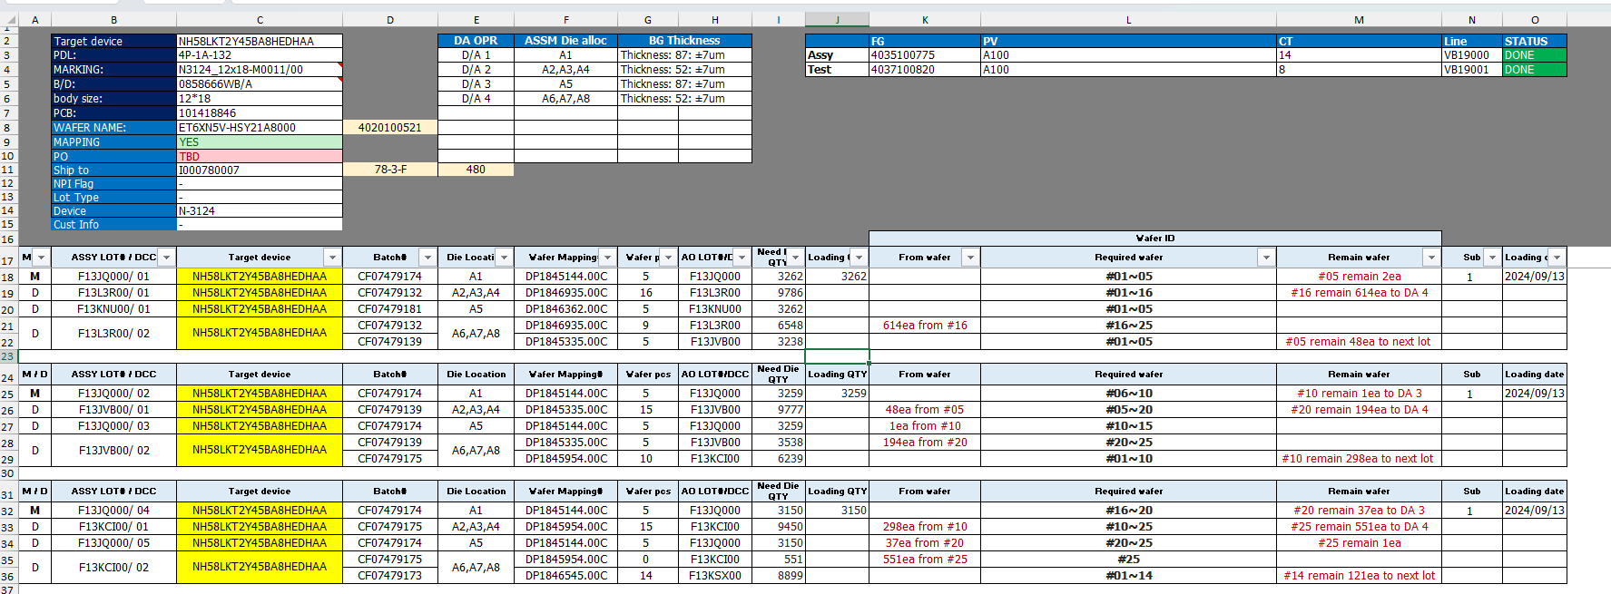
Proposal for ATV
In first stages, PCS proposes to use system to auto assign loading plan.
PCS provides rule and logic for system.
PCS will upload Excel file (format is fixed), include necessary information.
Based on available information and rule, system auto assign loading plan and create the output to be complete loading plan in format of Excel file.
PCS download this Excel file, schedule on system.
Figure A
Figure B

